Slide 1
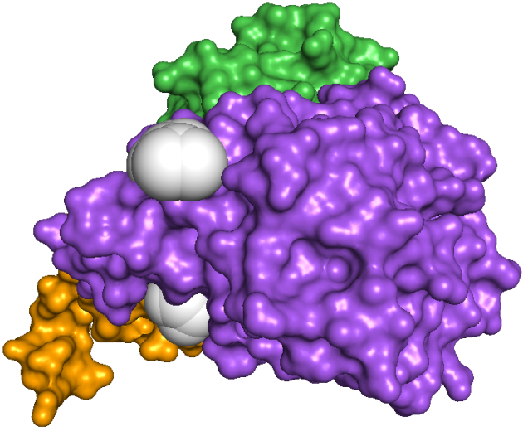
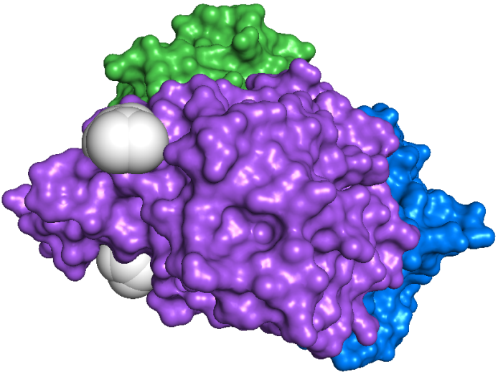
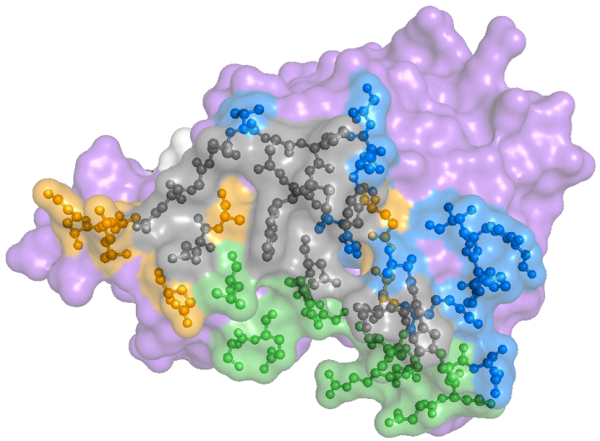
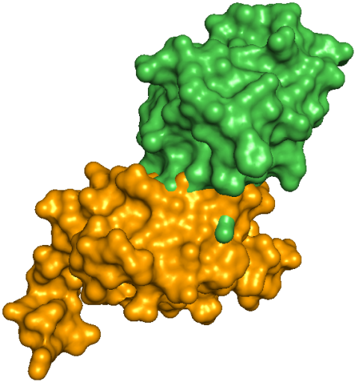
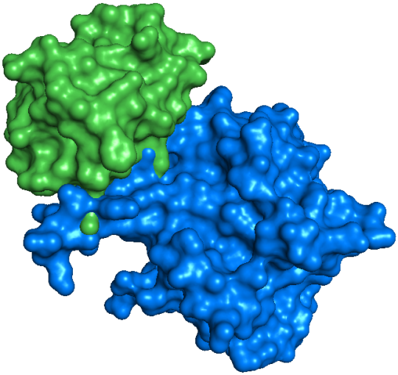
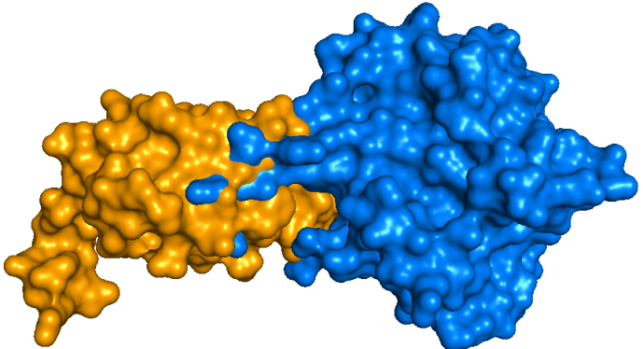
Core residues shared by Hpr, NanE, and U-PII
A
B
HPr
C
N221
W224
MET 223
N
NanE
N
U-PII
NagB
C
ASP 165
C
Binding interface shared by NanE and U-PII
E
D
X

